Slide 1

7023T
Advanced Database Systems
Session 05
Dimensional Modelling 1
This presentation is based on Michael A. Fudge, Jr.

Slide 2
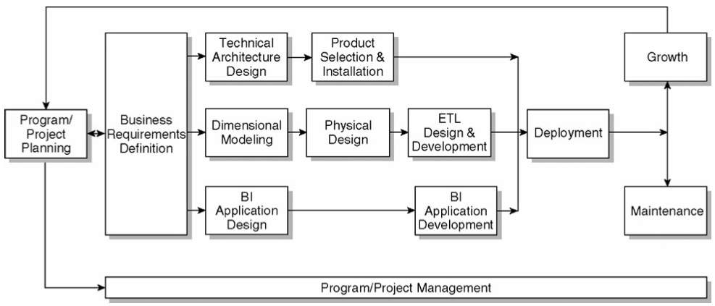
The Kimball Lifecycle Diagram

Slide 3
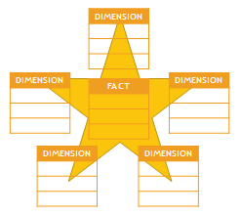
What is Dimensional Modelling
Dimensional modeling
Logical design technique for structuring data
It is intuitive to business users
Easy-to-understand
Fast query performance
Primary constructs of a dimensional model:
fact tables
dimension tables

Slide 4
Dimensional Model Example

Slide 5

The need for ER modeling?
Problems with early COBOLian data processing systems.
Data redundancies
From flat file to Table, each entity ultimately becomes a Table in the physical schema.
Simple O(n²) Join to work with Tables

Slide 6
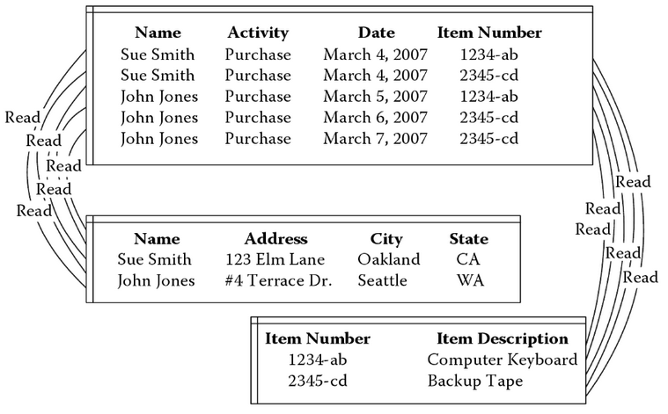
COBOL Data Example

Slide 7

Why ER Modeling has been so successful?
Coupled with normalization drives out all the redundancy out of the database.
Change (or add or delete) the data at just one point.
Can be used with indexing for very fast access.
Resulted in success of OLTP systems.

Slide 8
Need for DM: Un-answered Qs
Lets have a look at a typical ER data model first.
Some Observations:
All tables look-alike, as a consequence it is difficult to identify:
Which table is more important ?
Which is the largest?
Which tables contain numerical measurements of the business?
Which table contain nearly static descriptive attributes?

Slide 9

Need for DM: Complexity of Representation
Many topologies for the same ER diagram, all appearing different.
Very hard to visualize and remember.
A large number of possible connections to any two (or more) tables

Slide 10
Need for DM: The Paradox
The Paradox: Trying to make information accessible using tables resulted in an inability to query them!
ER and Normalization result in large number of tables which are:
Hard to understand by the users (DB programmers)
Hard to navigate optimally by DBMS software
Real value of ER is in using tables individually or in pairs
Too complex for queries that span multiple tables with a large number of records

Slide 11
ER vs. DM
ER | DM
Constituted to optimize OLTP performance. | Constituted to optimize DSS query performance.
Models the micro relationships among data elements. | Models the macro relationships among data elements with an overall deterministic strategy.
A wild variability of the structure of ER models. | All dimensions serve as equal entry points to the fact table.
Very vulnerable to changes in the user's querying habits, because such schemas are asymmetrical. | Changes in users' querying habits can be accommodated by automatic SQL generators.

Slide 12
3NF ER Diagram

Slide 13
Star Schema

Slide 14

Benefits of Dimensional Modelling
Dimensional hierarchies are collapsed into a single table for each dimension. Loss of Information?
A single fact table created with a single header from the detail records, resulting in:
A vastly simplified physical data model!
Fewer tables (thousands of tables in some ERP systems).
Fewer joins resulting in high performance.
Some requirement of additional space.

Slide 15
Fact Tables
Measurements associated with a specific business process
Process events produce fact records
Facts (attributes) are usually
Numeric
Additive
Tend to have huge numbers of records
Classification values help define subsets

Slide 16
Non-Additive Facts
Semi-additive
Cannot be summed across time periods
Examples: account balances, inventory levels
Non-additive
Cannot be summed across any dimension
Are stored in dimension tables

Slide 17

Fact Table Keys
Complex key that consists of foreign keys from intersecting dimension tables
Every foreign key must match a unique primary key in the corresponding dimension table
Foreign keys should not be null
Special keys such as “unknown”, “N/A”, etc. should be used instead.

Slide 18

Fact Table Granularity
Grain: level of detail of the table
Data should be at the lowest, most detailed atomic grain captured by a business process
Flexibility in querying/reporting
Scalability

Slide 19
Dimension Tables
Consist of highly correlated groups of attributes that represent key objects in business such as products, customers, employees, facilities
Store attributes for:
Query constraining/filtering
Query result labeling
Dimensions
Can be easily identified when business users use “by” word
Example: by year, by product, by region, etc.

Slide 20
Dimension Attributes
Textual fields
Numeric values that behave like text
Non-additives
Requirements
Labels consist of full worlds
Descriptive
No missing values
Discretely valued (contain only 1 value for each row in the dimension table)
Quality assured (no misspelling, obsolete or orphaned values, different versions of the same attribute)

Slide 21
Dimension Tables
Dimension tables are small with regard to the number of rows
Storing descriptions for each attribute is critical
Easy-to-use for business users
Rows are uniquely identified by a single key, usually, a sequential surrogate key (not original primary key)

Slide 22
Advantages of Surrogate Keys
Performance
Efficient joins*
smaller indexes**
more rows per block**
Data integrity
When the keys in operational systems are changed
Discontinued products, Deceased customers, etc.
Mapping when integrating data from different sources
Keys from different sources may be different
Mapping table of the surrogate key and keys from different sources
Notes:
* Date dimension for example
** Replace custID with a 4 byte integer would save significant space

Slide 23
Advantages of Surrogate Keys
Handling unknown or N/A values
Ease of assignment a surrogate key value to rows with these values
Tracking changes in dimensional attribute values
Creating new attributes and assigning the next available surrogate key

Slide 24
Conformed Dimensions
A.k.a. master or common reference dimensions
Shared across the DW environment joining to multiple fact tables representing various business processes
2 types
Identical dimensions
One dimension being a subset of a more detailed dimension

Slide 25
Conformed Dimensions
Identical dimensions
Same content, interpretation, and presentation regardless of the business process involved
Same keys, attribute names, attribute definitions, and domain values regardless of domain values they join to
Example: product dimension referenced by orders and the one referenced by inventory are identical
One dimension being a perfect subset of a more detailed, granular dimension table
Same attribute names, definitions, and domain values
Example: sales is linked to a dimension table at the individual product level; sales forecast is linked at the brand level

Slide 26
Conformed Dimensions
Product Dimension
Product key PK
Product description
SKU number
Brand description
Sub class description
Class description
Department description
Color
size
Display type
Sales Fact
Date key FK
Product key FK
… other FKeys…
Sales quantity
Sales amount
Sales Forecast Fact
Month key FK
Brand key FK
… other FKeys…
Forecast quantity
Forecast amount
Brand Dimension
Brand key PK
Brand description
Sub class description
Class description
Department description
Display type
Notes:
sales forecast facts are
captured at the granularity of a brand rather than an individual product, so you need a
shrunken brand dimension that conforms to the product dimension. Attributes that are
common to both the detailed product dimension and shrunken brand dimension
should be labeled, defined, and valued identically in both tables, even though the
entire tables are not identical.

Slide 27
Conformed Dimensions Benefits
Consistency
Every fact table is filtered consistently and results are labeled consistently
Integration
Users can create queries that drill across fact tables representing different processes individually and then join result set on common dimension attributes
Reduced development time to market
Once created, conform dimensions are reused

Slide 28

Four-Step Dimensional Design Process
Choose the Business Process
Choose the Grain
Choose the Facts
Choose the Dimensions

Slide 29
Step-1: Choose the Business Process
A business process is a major operational process in an organization.
Typically supported by a legacy system (database) or an OLTP.
Examples: Orders, Invoices, Inventory etc.
Business Processes are often termed as Data Marts and that is why many people criticize DM as being data mart oriented.

Slide 30
Step-2: Choosing the Grain
Grain is the fundamental, atomic level of data to be represented.
Grain is also termed as the unit of analyses.
Example grain statements
Typical grains
Individual Transactions
Daily aggregates (snapshots)
Monthly aggregates
Relationship between grain and expressiveness.
Grain vs. hardware trade-off.

Slide 31
Step-2: Relationship b/w Grain
LOW Granularity
HIGH Granularity
Four aggregates per week
4 x 4 = 16 values
Two aggregates per week
2 x 4 = 8 values
Daily aggregates
6 x 4 = 24 values

Slide 32
The case FOR data aggregation
Works well for repetitive queries.
Follows the known thought process.
Justifiable if used for max number of queries.
Provides a “big picture” or macroscopic view.
Application dependent, usually inflexible to business changes (remember lack of absoluteness of conventions).

Slide 33
The case AGAINST data aggregation
Aggregation is irreversible.
Can create monthly sales data from weekly sales data, but the reverse is not possible.
Aggregation limits the questions that can be answered.
What, when, why, where, what-else, what-next
Aggregation can hide crucial facts.
The average of 100 & 100 is same as 150 & 50

Slide 34
Aggregation hides crucial facts Example
 | Week-1 | Week-2 | Week-3 | Week-4 | Average
Zone-1 | 100 | 100 | 100 | 100 | 100
Zone-2 | 50 | 100 | 150 | 100 | 100
Zone-3 | 50 | 100 | 100 | 150 | 100
Zone-4 | 200 | 100 | 50 | 50 | 100
Average | 100 | 100 | 100 | 100
Just looking at the averages i.e. aggregate

Slide 35
Aggregation hides crucial facts chart
Z1: Sale is constant (need to work on it)
Z2: Sale went up, then fell (need of concern)
Z3: Sale is on the rise, why?
Z4: Sale dropped sharply, need to look deeply.
W2: Static sale

Slide 36
Step 3: Choose Facts statement
Facts
“We need monthly sales in
volume and US$. by
week, product and zone”
Dimensions

Slide 37
Step 3: Choose Facts
Choose the facts that will populate each fact table record.
Remember that best Facts are Numeric, Continuously Valued and Additive.
Example: Quantity Sold, Amount etc.

Slide 38
Step 4: Choose Dimensions
Choose the dimensions that apply to each fact in the fact table.
Typical dimensions: time, product, geography etc.
Identify the descriptive attributes that explain each dimension.
Determine hierarchies within each dimension.

Slide 39
Step-4: How to Identify a Dimension?
The single valued attributes during recording of a transaction are dimensions.
Fact Table
Calendar_Date
Time_of_Day
Account _No
ATM_Location
Transaction_Type
Transaction_Amount
Dim
Time_of_day: Morning, Mid Morning, Lunch Break etc.
Transaction_Type: Withdrawal, Deposit, Check balance etc.

Slide 40
Step-4: Can Dimensions be Multi-valued?
Are dimensions ALWAYS single?
Not really
What are the problems? And how to handle them
How many maintenance operations are possible?
Few
Maybe more for old cars.
Calendar_Date (of inspection)
Reg_No
Technician
Workshop
Maintenance_Operation

Slide 41
Step-4: Dimensions & Grain
Several grains are possible as per business requirement.
For some aggregations certain descriptions do not remain atomic.
Example: Time_of_Day may change several times during daily aggregate, but not during a transaction
Choose the dimensions that are applicable within the selected grain.

